Slide 1
August 14th, 2024

Slide 2

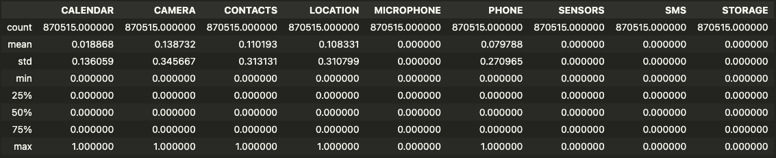

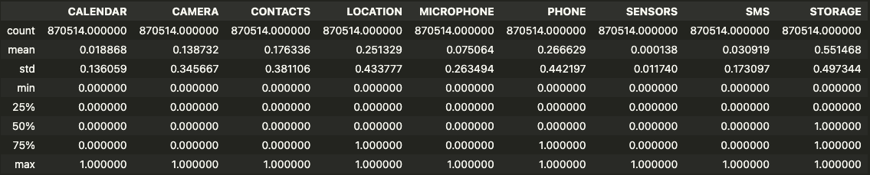
Previously:
Now:

Slide 3
Differences in AUC scores (with corrected permissions vs. paper)
Developer-Centered (1 Classifier)
Evaluation/Validation AUC:
0.757 (0.764) -0.7%
Testing AUC:
0.755 (0.762) -0.7%
User-Centered (11 Classifiers)
Evaluation/Validation AUC:
0.797 (0.798) -0.1%
Testing AUC:
0.794 (0.792) +0.2%

Slide 4
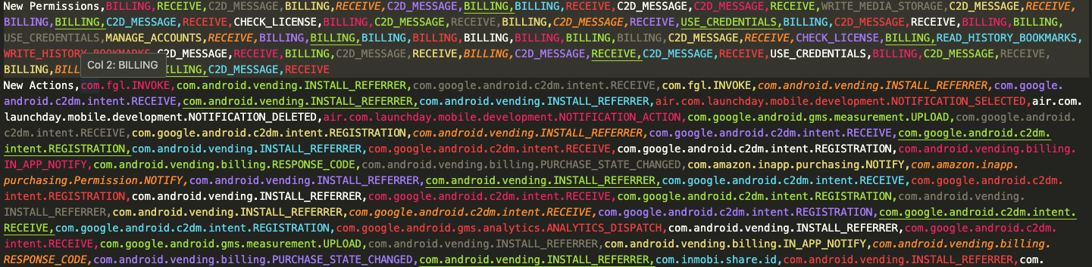
Many new permissions and actions not hardcoded into our read permissions script

Slide 5
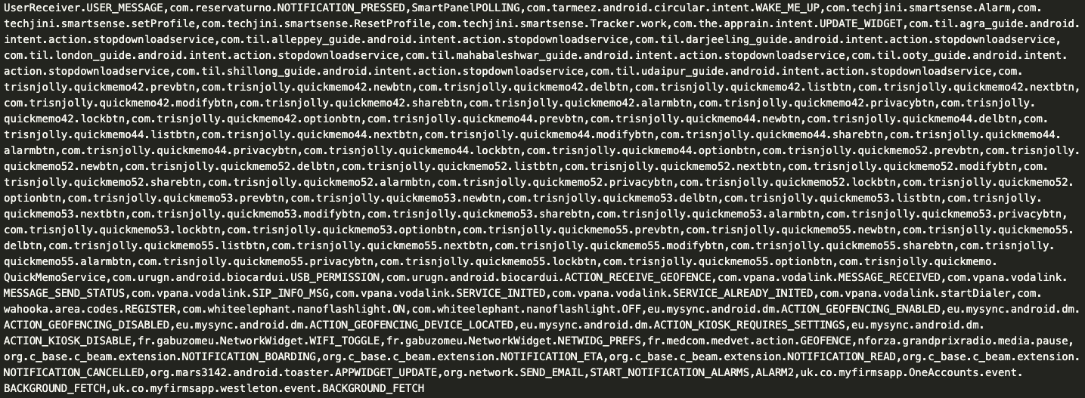
Potential difficulty with new permissions and actions:
There are many, many unique perms/acts. May be hard to categorize them

Slide 6
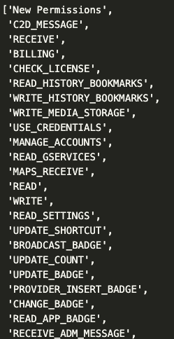
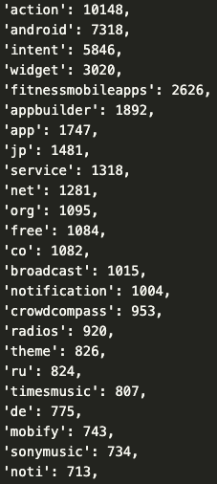
New permissions
New actions
Could try making groups for billing, credentials, settings, badge, among others

